Slide 1


Proposals
Presented By :Sineha Mandhan
:Sineha Chawla
:Sajida Khatoon
Assigned By :Maria Fatima

Slide 2

What is Proposals?
Proposals are formal written documents that outline a plan or solution to a specific problem or need. They are used to pitch ideas, secure funding, or win business opportunities across various industries and sectors.
by Sineha Mandhan

Slide 3

Two Types of Proposals
Internal proposal
External proposal
internal proposals serve as a mechanism for generating and implementing innovative ideas, solving problems, improving efficiency, and driving positive change within an organization.
An external proposal is a formal document prepared by one organization and presented to another organization, typically with the aim of winning business, securing funding, or establishing a partnership..

Slide 4
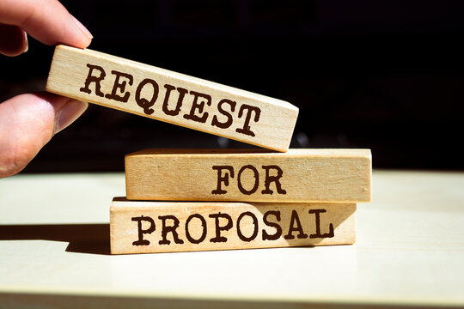
Request for Proposals
A Request for Proposal (RFP) is a formal document issued by an organization, government agency, or client that outlines a specific problem or need they are looking to address. The RFP invites qualified vendors, service providers, or contractors to submit a detailed proposal outlining their solution and approach. This competitive process allows the client to evaluate multiple proposals and select the best fit.

Slide 5
Criteria for a Successful Proposal
Title Page
Cover Letter
Table of Content
List of Illustration
Abstract
Introduction
Discussion
Conclusion
Glossary
Works Cited
Appendix

Slide 6

1.Title Page
The title page sets the tone and introduces the key elements of the proposal. the first page of a paper or report that lists basic information, such as the title, author(s), course name, instructor, date, and sometimes the name of the institution.

Slide 7
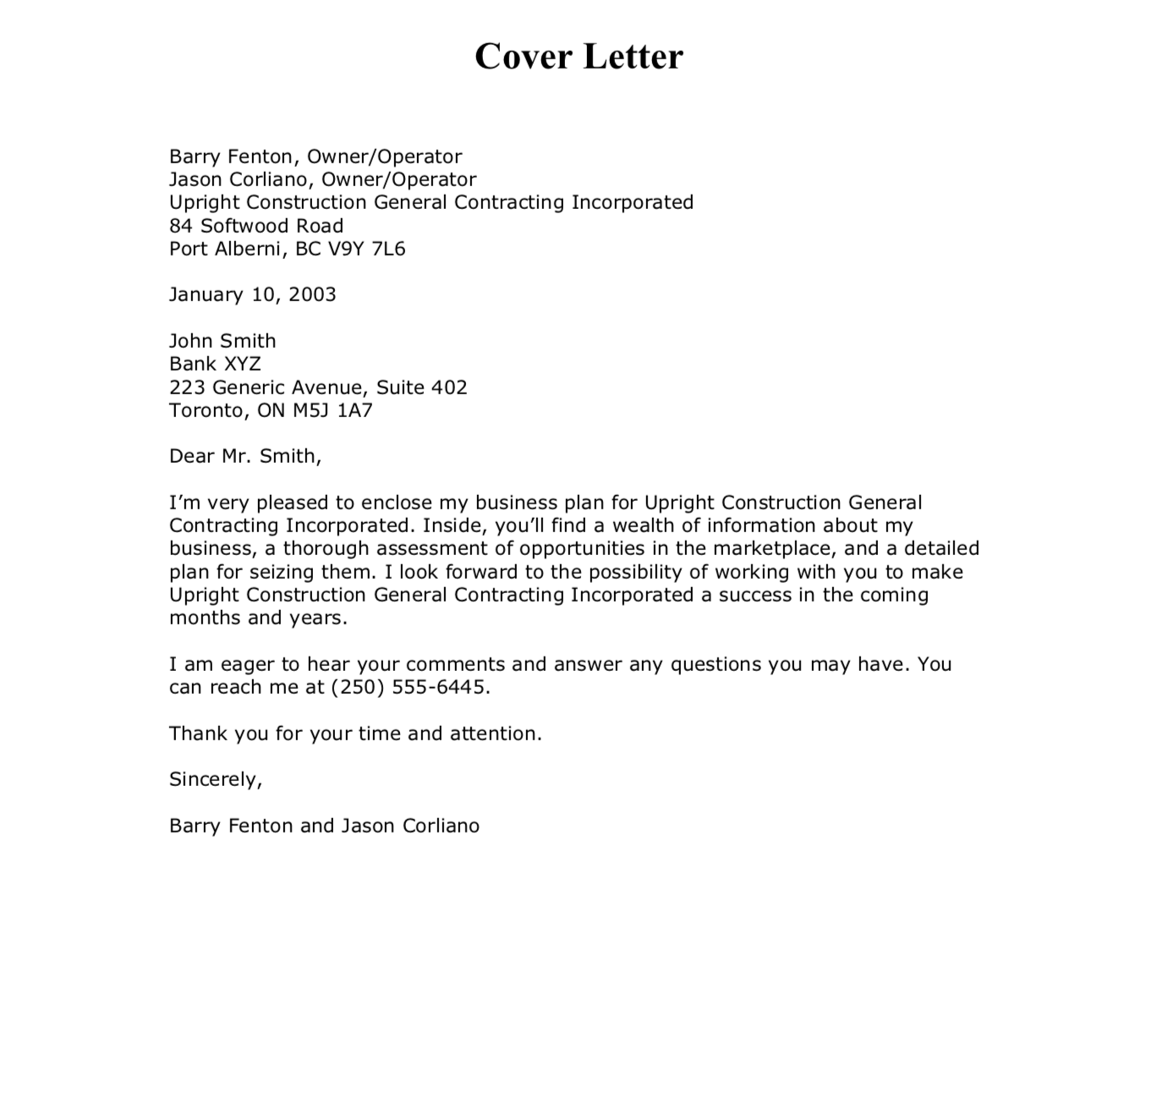
2.Cover Letter
The cover letter is a concise, personalized introduction that highlights the key points of the proposal. It establishes a connection with the reader, showcases your understanding of their needs, and outlines the unique value your solution can provide.

Slide 8
3.Table Of Content
Executive Summary
Project Overview
Proposed Solution
Implementation Plan
Team Qualifications
Project Timeline
Budget and Pricing
Supporting Documentation

Slide 9
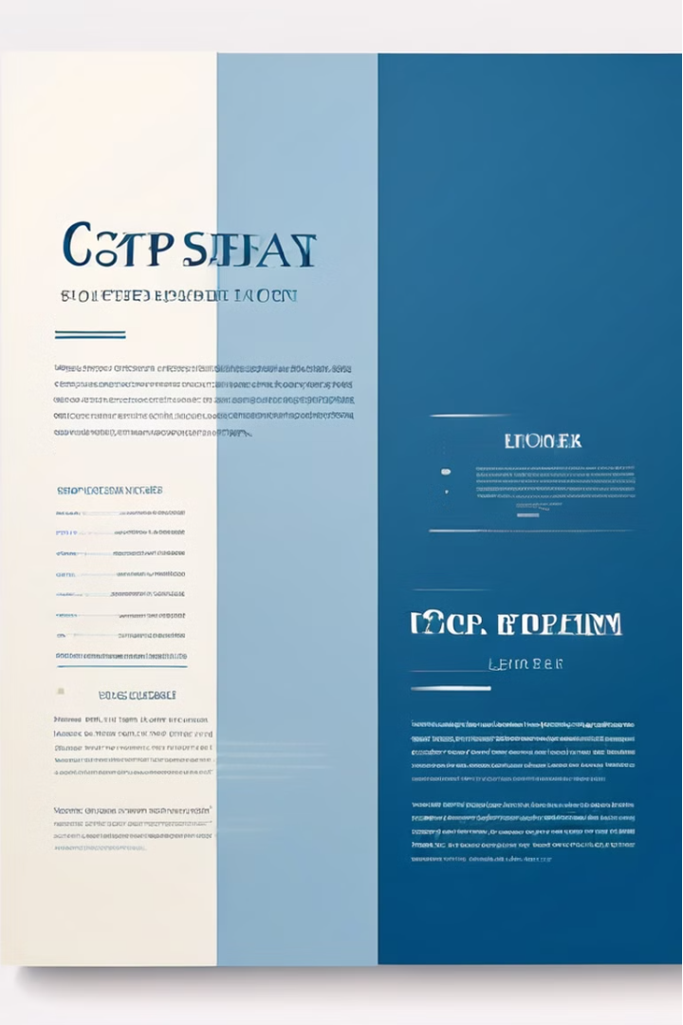
4.List Of Illustrations
In proposal writing, a list of illustrations typically includes any visual aids or graphics referenced within the proposal document. This list helps readers quickly locate and reference the visual elements included in the proposal.
The list should be clear and informative.
Do not waste your and your reader’s time by providing a poor list of illustration

Slide 10


5.Abstract
The abstract provides a concise summary of the key points and highlights of the proposal. It outlines the problem statement, the proposed solution, and the key benefits the client can expect. The abstract is designed to capture the reader's attention and pique their interest in reviewing the full proposal.

Slide 11

6.Introduction
The introduction sets the stage for the proposal by providing context and outlining the key objectives. It should highlight the client's needs, the proposed solution, and the unique value your organization can deliver.

Slide 12

7.Discussion
the discussion section serves as a critical component where the proposer can delve into the details of the proposed solution or approach. This section provides an opportunity to explain, analyze, and justify the proposed solution in depth. The discussion should effectively communicate the relevance, feasibility, and benefits of the proposed approach to the intended audience.
by :Sajida Khatoon

Slide 13
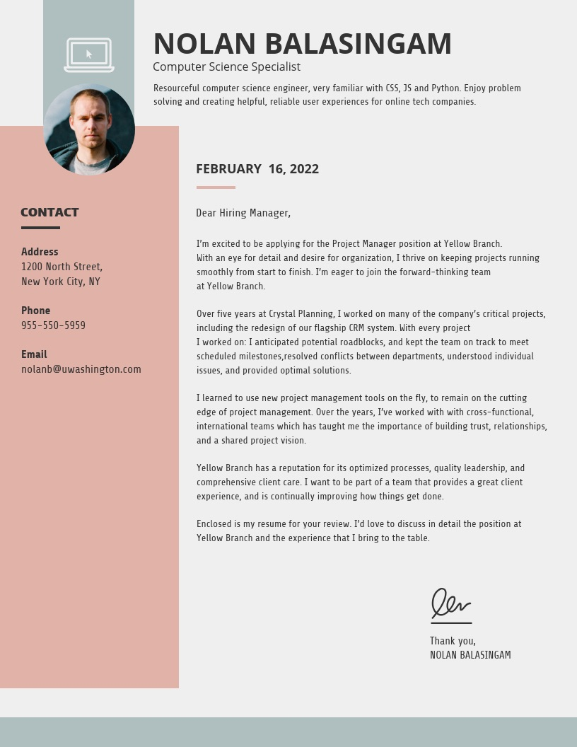
8.Conclusion
In the conclusion of a proposal, the synthesis of key points culminates in a compelling call to action. By succinctly summarizing the proposal's main elements and highlighting its benefits, the conclusion reinforces the proposal's significance. It serves as a pivotal moment to inspire confidence in the proposed solution's ability to address the identified need or problem. A well-crafted conclusion not only articulates the vision of success but also outlines clear next steps for implementation. Expressed with gratitude for the reader's consideration, the conclusion leaves a lasting impression, compelling the recipient to take action and embrace the proposed solution.

Slide 14
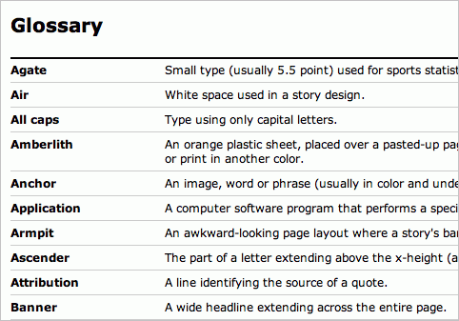
9.Glossary
In the conclusion of a proposal, the synthesis of key points culminates in a compelling call to action. By succinctly summarizing the proposal's main elements and highlighting its benefits, the conclusion reinforces the proposal's significance. It serves as a pivotal moment to inspire confidence in the proposed solution's ability to address the identified need or problem. A well-crafted conclusion not only articulates the vision of success but also outlines clear next steps for implementation. Expressed with gratitude for the reader's consideration, the conclusion leaves a lasting impression, compelling the recipient to take action and embrace the proposed solution.

Slide 15
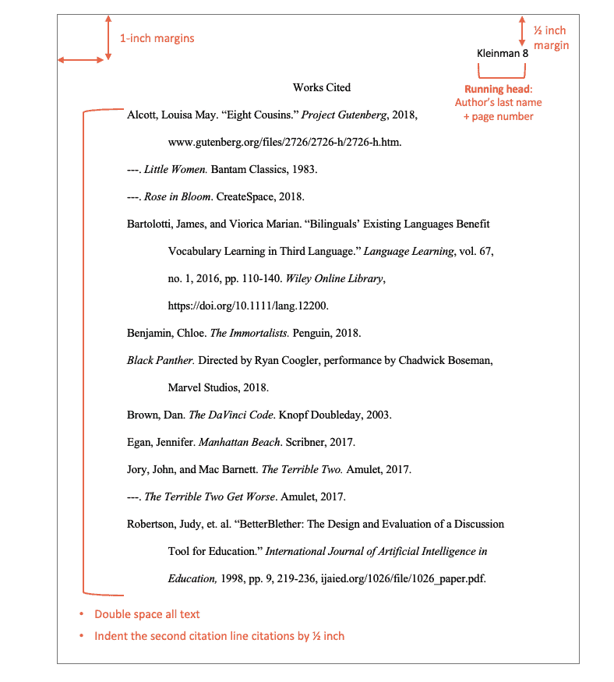
10. Works Cited
It not only acknowledges the sources that have contributed to the proposal's development but also provides readers with the opportunity to delve deeper into the referenced material. This section showcases the breadth and depth of research undertaken, demonstrating diligence and scholarly rigor. Furthermore, a comprehensive "Works Cited" instills confidence in the proposal's author, portraying them as knowledgeable and accountable. Ultimately, it upholds the principles of academic honesty and transparency, essential for fostering trust and respect in scholarly endeavors.

Slide 16
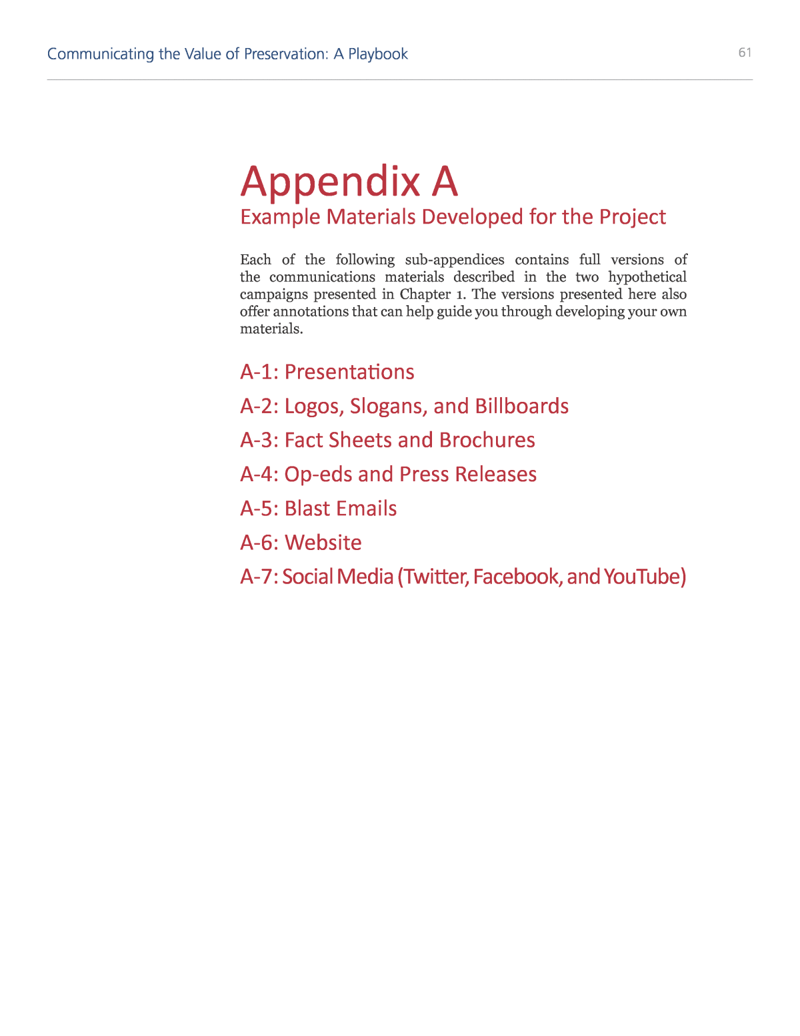
11. Appendix
The appendix of a proposal serves as a repository for supplementary information that enriches the main body of the document. It offers readers access to additional data, charts, graphs, or any material that might overwhelm the main text but is crucial for understanding the proposal's context or supporting its arguments. Organized and labeled systematically, the appendix ensures clarity and accessibility, allowing readers to navigate complex information effortlessly. Moreover, it provides a comprehensive view of the research process, offering transparency and aiding in the replication of studies or verification of findings. In essence, the appendix enhances the proposal's credibility by presenting a wealth of relevant information in a structured and accessible format.

